Slide 1

React Components
How to Compose in React ?
Software University
http://softuni.bg
Software University
http://softuni.bg

Slide 2

Table of Contents
Components
Props
State
Component Lifecycle
Fetching Data

Slide 3
Have a Question?
sli.do #js-web

Slide 4
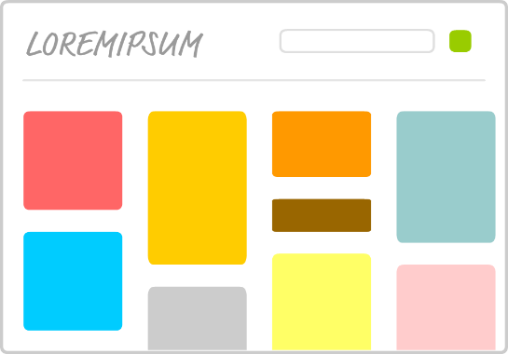
Components Overview
Syntax, Functional and Class Components

Slide 5

Components Overview
Components are like JavaScript functions
They are reusable pieces that can be composed
Think about each piece in isolation
You can customize them with props and state

Slide 6
Continued…. Rendering
const items = ['Item 1', 'Item 2', 'Item 3', 'Item 4'];
const Navigation = () => {
return (
<ul>{items.map(item => <li>{item}</li>}</ul>
)
}

Slide 7
Functional Components
There are two main types of components in React:
Functional Components
Class Components
A functional component is a JavaScript function that returns JSX
function Hello(props){
return <div>Hello {props.name}</div>
}

Slide 8
Class Components
Class components give you access to several features such as
State and modifying state
Lifecycle hooks
class Hello extends React.Component {
constructor(props) {
super(props); }
render() { return (
<div>Hello {this.props.name}</div>
); } }
Call base contructor
Use this to access props inside class components

Slide 9

Component Syntax
Names always start with uppercase
Tags must be closed
If there are no children – use self-closing tags
Information is passed via props
<Dropdown> A dropdown list
<UserHead name="homeHeader" />
<Menu>
<MenuItem>Do Something</MenuItem>
<MenuItem>Do Something Fun!</MenuItem>
<MenuItem>Do Something Else</MenuItem>
</Menu>
</Dropdown>;

Slide 10

Component Props
Passing Data, Access and Usage

Slide 11
Component Props
Props is short for properties
Props is just a simple JavaScript object
Similar to HTML attributes – used to pass data to components
They should be considered immutable (read-only)
A component should never modify it's own props!
function Welcome (props) {
return <h1>Hello, {props.name} </h1>
}

Slide 12
Passing Props to Nested Components
We use props to pass data from parent to child
const BookList = () => {
return (
<ul>
<Book
title="IT"
author="Stephen King" price="20"
/>
<Book
title="The Hunger Games" author="Suzanne Collins" price="10"
/>
</ul>
);
};
Prop name should start with lowercase letter
Use className to set css classes
const Book = (props) => {
return (
<li className="book">
<div>{props.title}</div>
<div>{props.author}</div>
<div>{props.price}</div>
</li>
);
};

Slide 13
Passing Props in Class Components
Pass props inside constructor and use this to access them
class Book extends React.Component {
constructor(props) {
super(props); }
render() {
return (
<li className="book">
<div>{this.props.title}</div>
<div>{this.props.author}</div>
<div>{this.props.price}</div>
</li>
);
}
}
Pass props to base component constructor

Slide 14
Children Property
Use children property to access information between opening and closing tags
const BookList = () => {
return (
<ul>
<Book
title="IT"
author="Stephen King"
price="20"
>
<span>
Some value here
</span>
</Book>
</ul>
);
};
const Book = (props) => {
return (
<li className="book">
…
<div>{props.children}</div>
</li>
);
};
Could be plain text or nested HTML

Slide 15

Live Demo

Slide 16

ON
OFF
Storing and Modifying Data
Component State

Slide 17
Component State Overview
The heart of every React component is its "state"
It determines how the component renders and behaves
State allows you to create components that are dynamic and interactive

Slide 18
Component State Example
State holds information that can change over time
Usually as a result of user input or system events
class Button extends React.Component {
constructor(props) {
super(props);
this.state = { count: 0 };
this.updateCount = this.updateCount.bind(this);
}
updateCount() {
this.setState((prevState) => { count: prevState.count + 1 });
}
render() {
return (<button onClick={this.updateCount}>
Clicked {this.state.count} times</button>);
}
}

Slide 19
Working With States Overview
State is used only with class-based components
Default state can be set in the constructor
To access state
State must never be directly modified
Use this.setState instead
New state will be merged with old state
console.log(this.state);

Slide 20
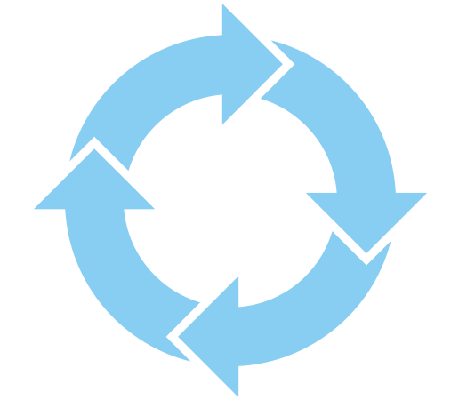
Concepts, Usage and Event Hooks
Concepts, Usage and Event Hooks

Slide 21
Component Lifecycle - Mounting
constructor(props)
getDerivedStateFromProps(props, state)
render()
Render Child Components

Slide 22
Component Lifecycle
Components emit lifecycle events during operation
Those events can be used to perform initialization, fetch remote data, cleanup, etc.
Detailed information: https://reactjs.org/docs/state-and-lifecycle.html
Mount
Update
Dismount

Slide 23
componentDidMount() Hook
The hook is triggered after your component has been rendered
This is the point when you should initiate AJAX requests
Its good practice to add all your event listeners
Calling setState from this point on will cause a re-render
componetDidMount() {
fetch('https://gitconnected.com')
.then((res) => {
this.setState({
user: res.user
});
});
}

Slide 24
componentWillUnmount () Hook
This method is triggered right before the component dismounts
Here you can clean up everything that was associated with the UI
componentWillUnmount() {
window.removeEventListener('resize',
this.resizeEventHandler);
}

Slide 25

Using Fetch API
Fetching Remote Data

Slide 26
Fetch API
The Fetch API provides an interface for fetching resources
This method takes one mandatory argument, the path
It returns a promise that resolves to the Response to that request
You can also pass in an init options object as the second argument

Slide 27
Fetch API Example
Fetch API with then/catch example:
fetch('https://api.github.com/users/xapuu')
.then((data) => data.json())
.then((d)=> console.log(d))
.catch((err)=> console.error(err))

Slide 28
Fetch API Example 2
Fetch API with async/await example:
(async ()=> {
try {
let d = await fetch('https://api.github.com/users/xapuu');
let forDisplay = await d.json();
} catch(e) {
console.log('Something went wrong!');
}
}
)()

Slide 29

Summary
Components are self-contained reusable elements
State and props can be used to pass information
Lifecycle events are fired during component operation
JSX supports the Fetch API
class Welcome extends React.Component {
render() {
return <h1>Hello, {this.props.name}</h1>;
}
}

Slide 30
https://softuni.bg/opencourses/reactjs-fundamentals

Slide 31













SoftUni Diamond Partners

Slide 32




SoftUni Organizational Partners

Slide 33




Trainings @ Software University (SoftUni)
Software University – High-Quality Education and Employment Opportunities
softuni.bg
Software University Foundation
http://softuni.foundation/
Software University @ Facebook
facebook.com/SoftwareUniversity
Software University Forums
forum.softuni.bg

Slide 34

License
This course (slides, examples, demos, videos, homework, etc.) is licensed under the "Creative Commons Attribution-NonCommercial-ShareAlike 4.0 International" license

